Slide 1
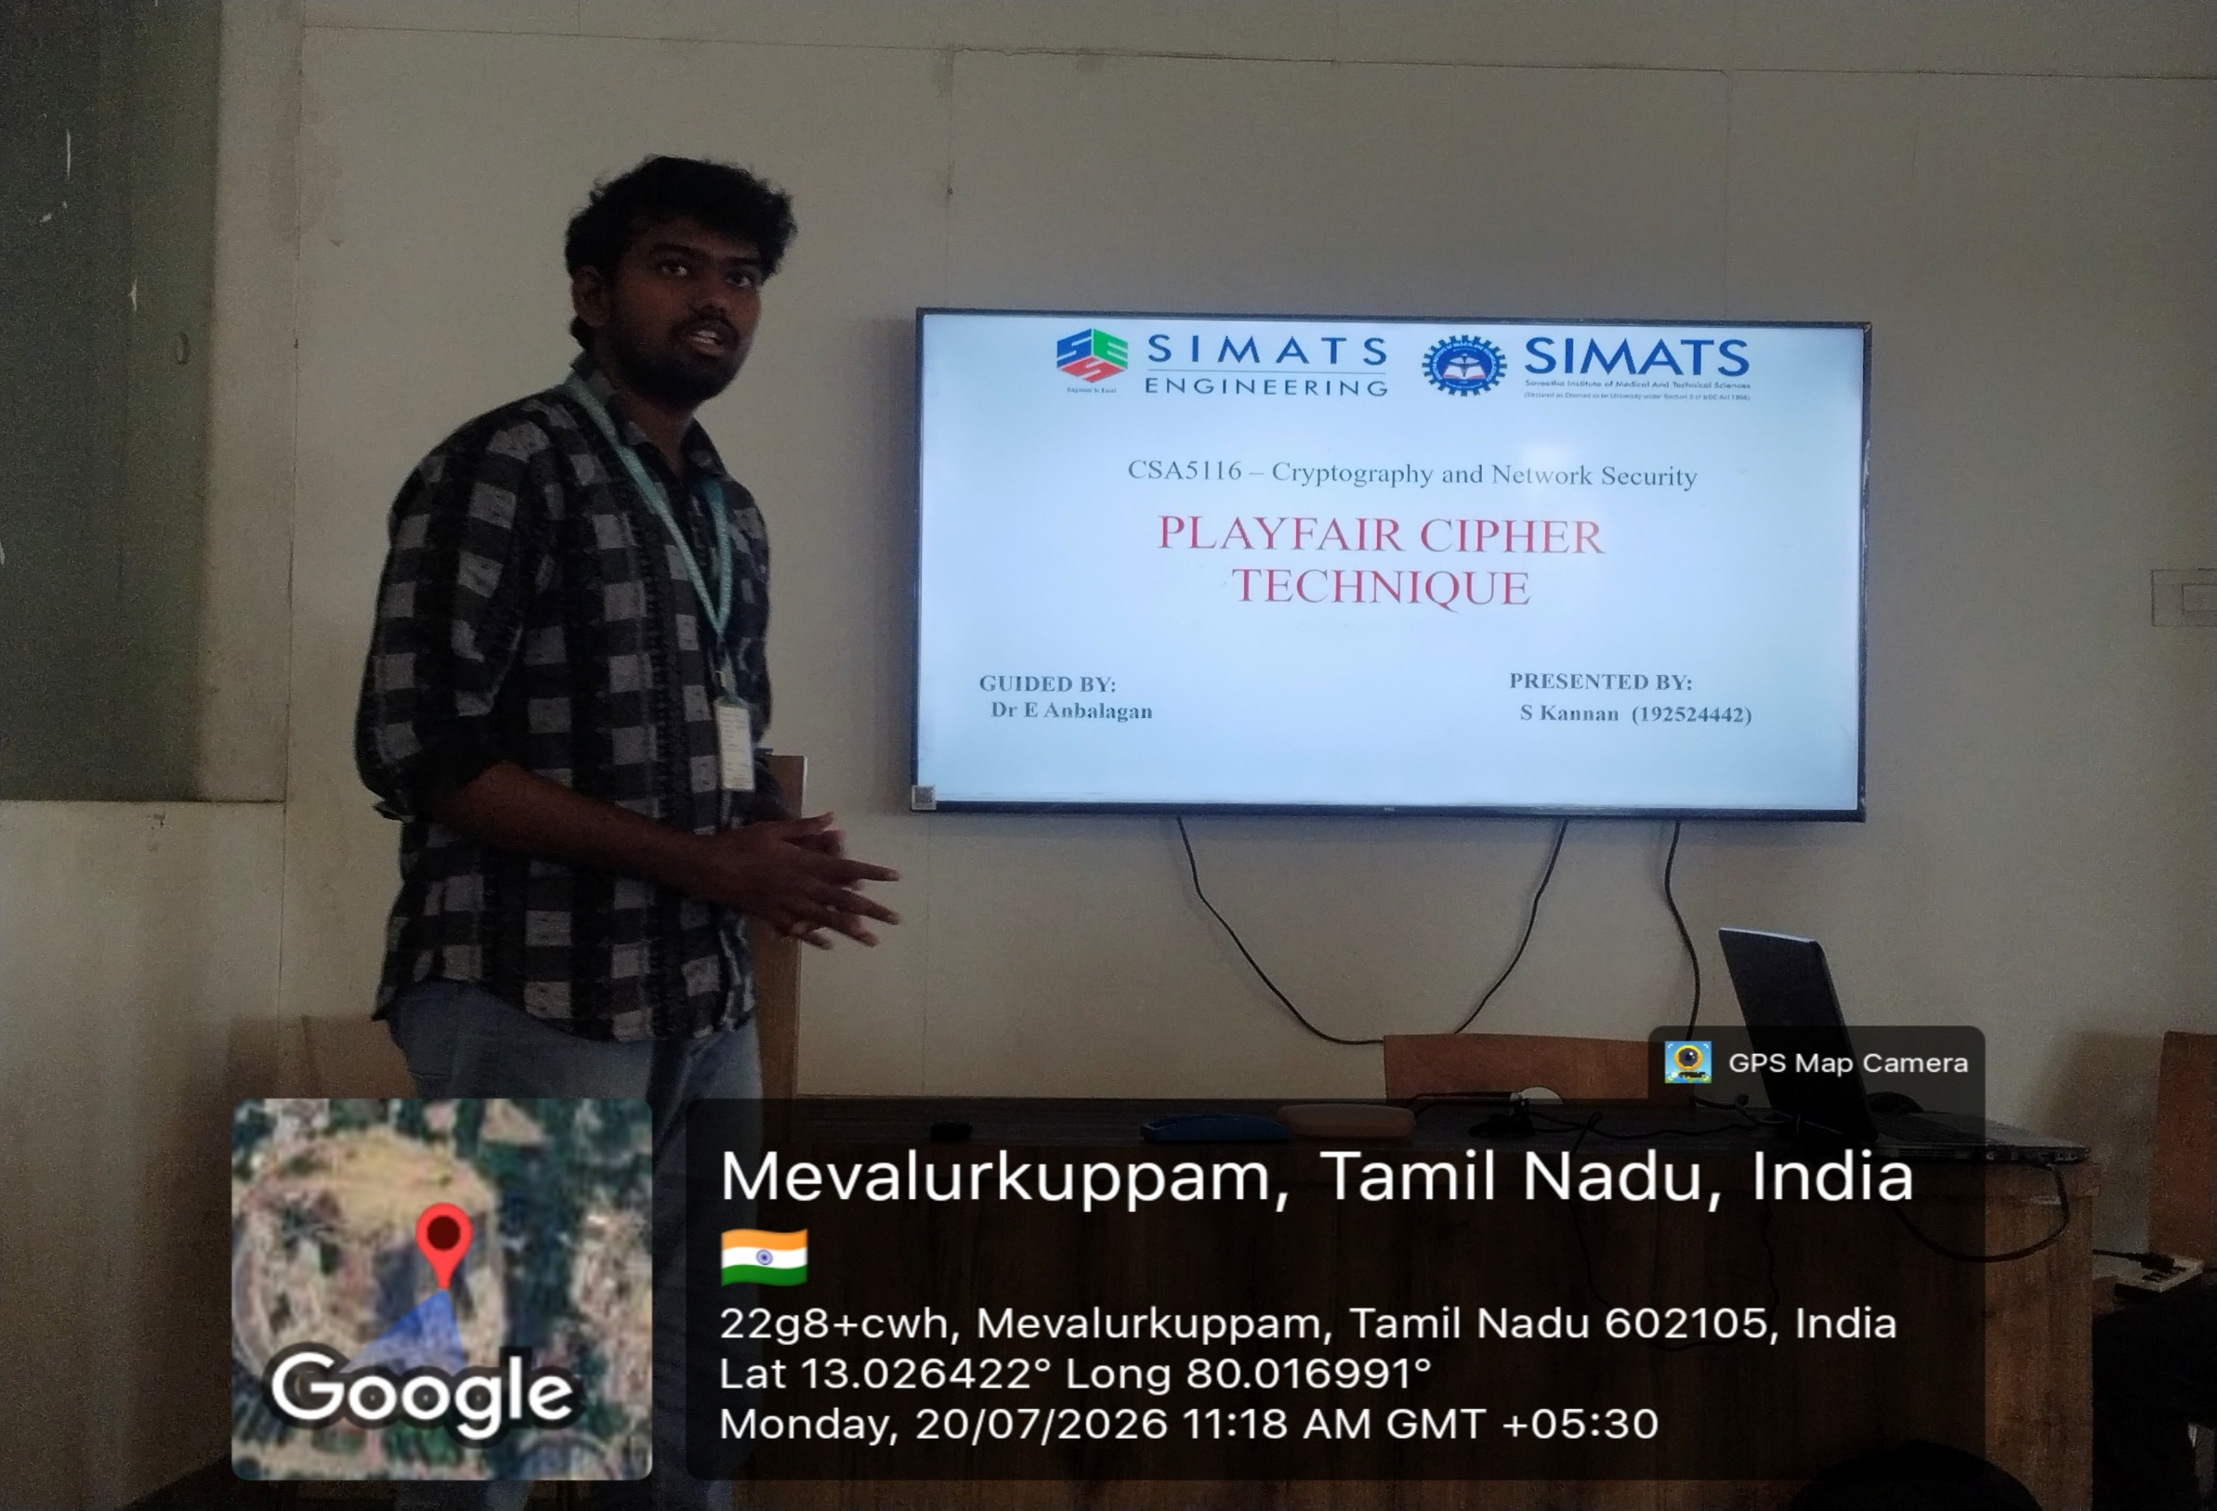

Slide 2

PLAYFAIR CIPHER TECHNIQUE
CSA5116 – Cryptography and Network Security
GUIDED BY:
Dr E Anbalagan
PRESENTED BY:
S Kannan (192524442)

Slide 3


INTRODUCTION
Substitution Technique:
i) Monoalphabetic Substitution Technique
Caesar Cipher
Monoalphabetic Substitution
ii) Polyalphabetic Substitution Technique
Viegnere cipher
Playfair cipher
Hill cipher

Slide 4
Encrypt using these rules:
Same row → Take the next letter to the right.
Same column → Take the letter below.
Rectangle → Replace each letter with the letter in the same row but the other letter's column.
Aim:
To securely encrypt and decrypt text using pairs of letters
Algorithm
Choose a keyword.
Create a 5 × 5 matrix using the keyword.
Combine I and J into one cell.
Fill the remaining letters of the alphabet
Divide the plaintext into pairs.
Insert X if two letters in a pair are the same.

Slide 5
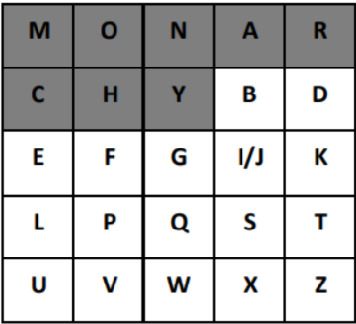
EXAMPLE OF PLAYFAIR CIPHER
Plaintext : HELLO
Keyword: MONARCHY
Split into pairs : HE LX LO
Encryption
HE → CF
LX → SU
LO → PM
CFSUPM

Slide 6
ADVANTAGES
More secure than simple substitution ciphers.
Encrypts two letters at a time.
Easy to implement manually.
Reduces frequency analysis attacks.
No complex calculations.
DISADVANTAGES
Limited to a 5×5 matrix. I and J are combined.
Vulnerable to modern cryptanalysis.
Slower for long messages.
Not suitable for today's secure communication.

Slide 7
THANH YOU

